Slide 1

SCALING UP THE MBH/DHIS2
TRACKER AND TRAINER APPLICATIONS
LibreHealth

Slide 2
MBHS/DHIS2 TRACKER AND TRAINER
#DHIS 2 - global public good transforming health information management around the world , developed by HISP(health information system program)
#DHIS2 has a modular, layered architecture with a strong and open application programming interface (API).
#It stores information from various sources , stored in dhis2 database and can be used to analyze the situation
#Also has an offline feature , that is sending SMS .
#Can be used in less internet areas also

Slide 3

LibreHealth (https://librehealth.io)
#LibreHealth is an umbrella organization(collaborative community) where multiple health information technology projects collaborate.
#The mission of LibreHealth is to help provide high quality medical care to all people, regardless of race, socioeconomic status, or geographic location, by providing medical practices and clinics across the globe access to free of charge medical software.

Slide 4
01
02
LIBRE HEALTH EHR APPLICATION
is a clinically focused electronic health record(EHR) system , which is easy to use and also customizable for use in a variety of health care settings
LIBRE HEALTH
TOOL KIT
is a software that serves as an foundational API and also is a data model for foundational applications (is a powerful REST API)
TRENDING WORKS OF LIBRE HEALTH ORGANIZATION

Slide 5
03
LIBREHEALTH RADIOLOGY
is an open source radiology information system , it manages the clinical workflow of radiology department , using DECOM (International standard to transmit, store, retrieve, print, process, and display medical imaging information)
TRENDING WORKS OF LIBRE HEALTH ORGANIZATION
**THE MAJOR TECHNOLOGIES USED ARE ANDROID,JAVA,JAVASCRIPT, PYTHON AND PHP**

Slide 6
DEVELOPING AN ANDROID APPLICATION FOR NEW BORN CLINICAL DECISION SUPPORT
Before we dive into the project , let’s understand what ECEB is?
# ECEB(essential care for every baby) is an educational and training program , developed by American academy of pediatrics , provides knowledge, skills, and competencies to nurses and doctors in low/middle-income settings so that they can provide life-saving care to newborns from birth through 24 hours postnatal(period after childbirth).
#The aim of this project is to develop an android mobile application , the ECEB digital action plan , that is purposely built to provide clinical decision-support for nurses and doctors delivering essential newborn care interventions(actions) during first day of life

Slide 7
FEATURES OF ECEB ANDROID APPLICATION
1. Time-stamping(recording time and date) births to generate an essential newborn care clock for babies.
2. Ability to track multiple babies at a time
3. Automated classification of babies health status , based on results from observations and assessments
4. Automated advice on management of babies , based on their classification
5. Reminders/Alerts to provide recommended essential newborn care interventions
6. If particular interventions are not delivered on time , then capture information regarding why this essential newborn care was late or missed

Slide 8
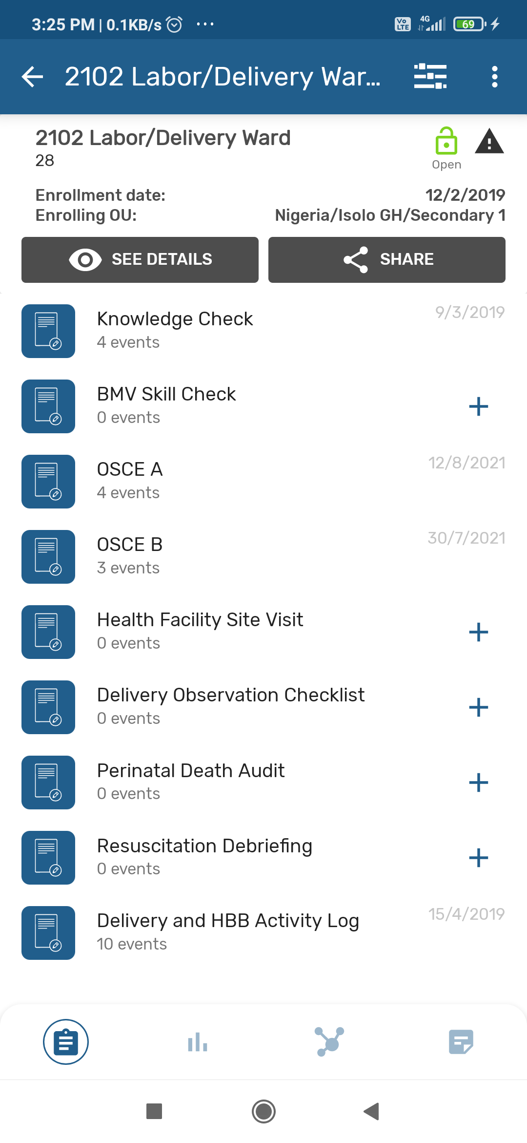
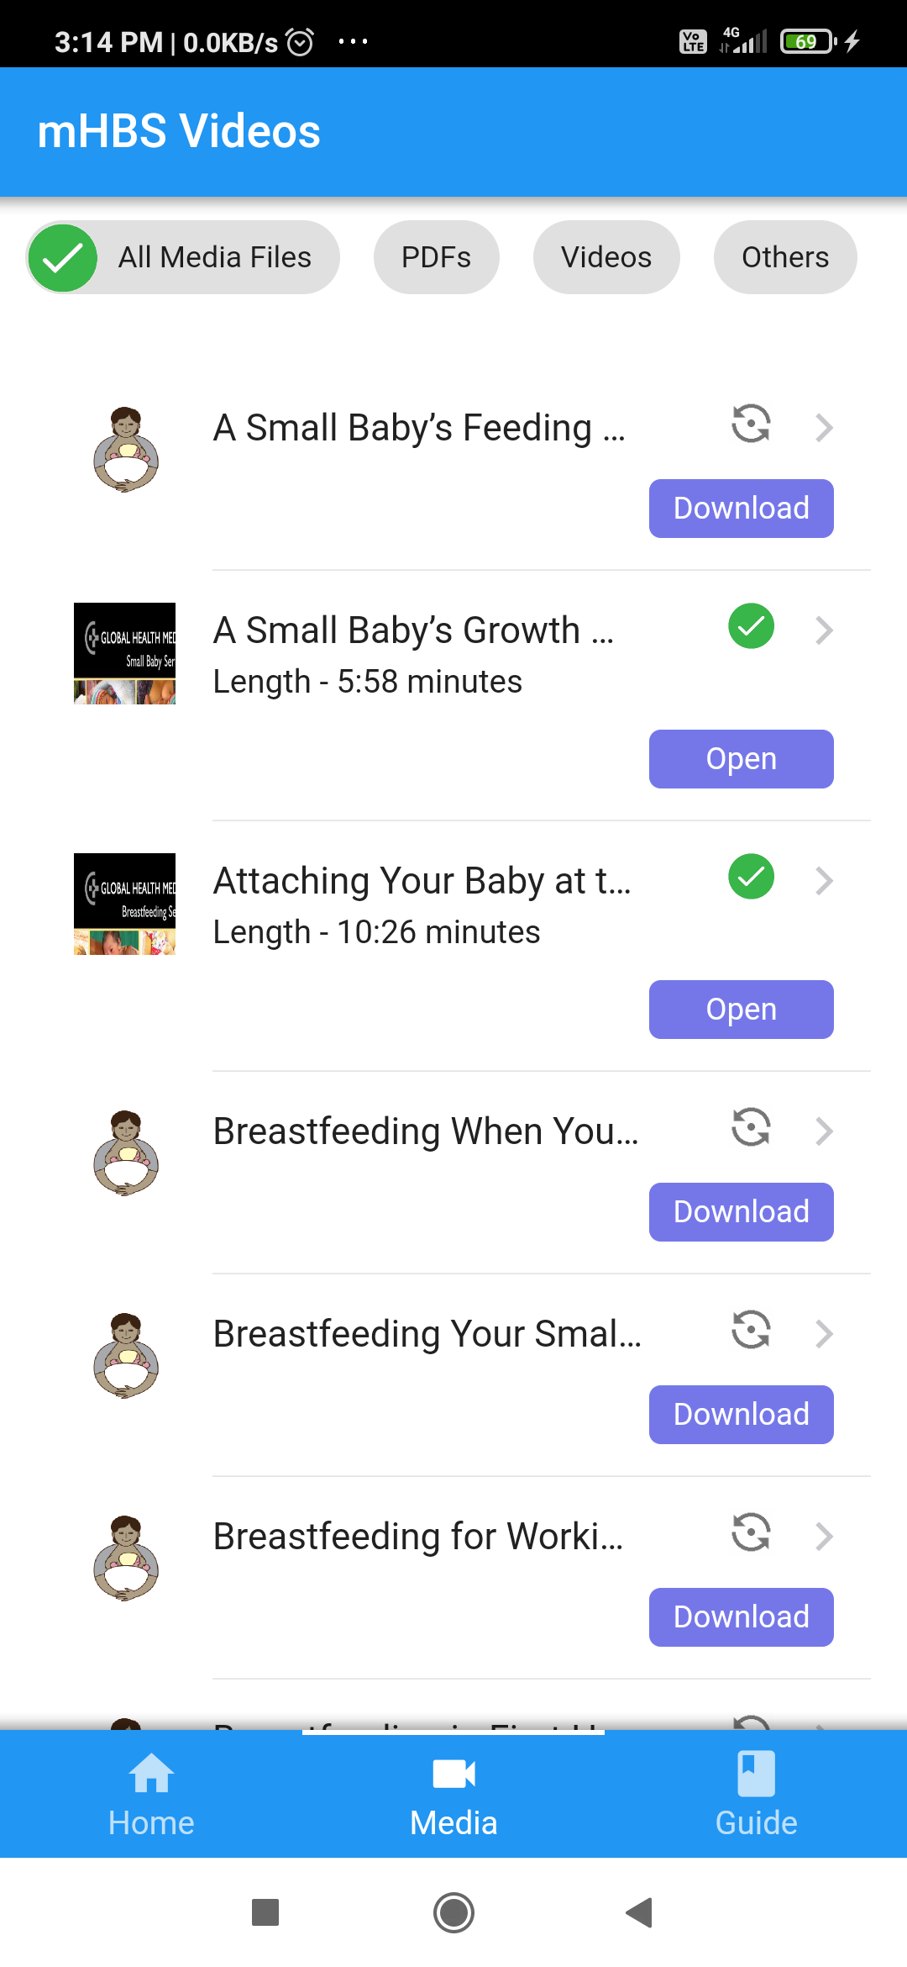
PROJECT 1
TRAINER APP
Mercury is the closest planet to the Sun and the smallest one in the Solar System. This planet's name has nothing to do with the liquid metal, since Mercury was named after the Roman messenger god
TRACKER APP

Slide 9
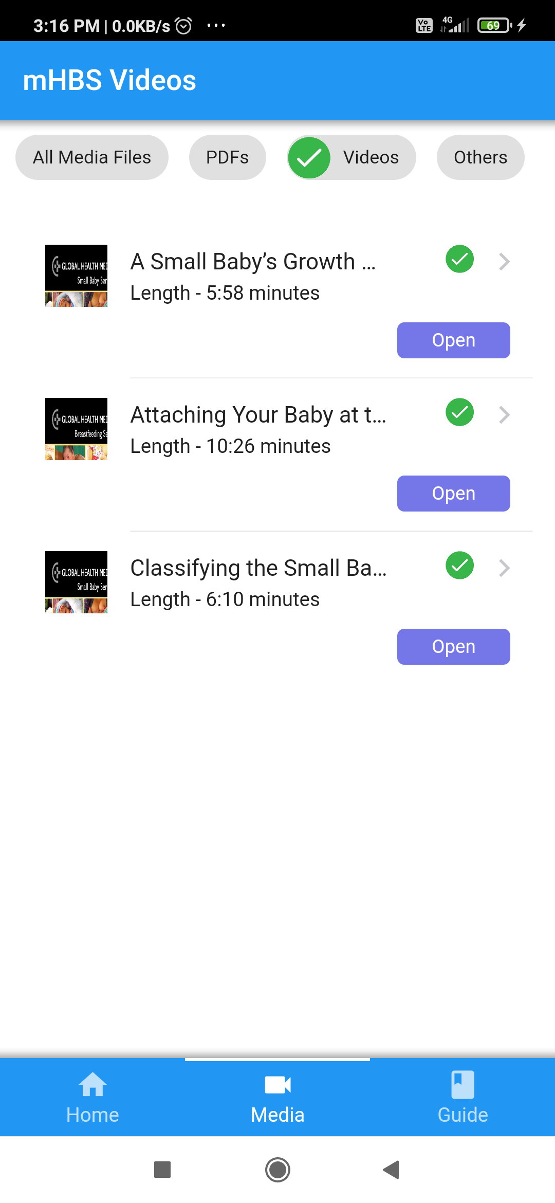
TRAINER APP
TECH :
# Cordova(html,css,javascript) , xml , framework7(free and open source HTML mobile framework to develop hybrid mobile apps or web apps with iOS or Android)
#Training for neonatal resuscitation through videos, guide and other kind of training material
FEATURES :
#Offline support and sync facility (using SQL)
#Uploading resources and accessing
#App usage tracking system (SQL)

Slide 10
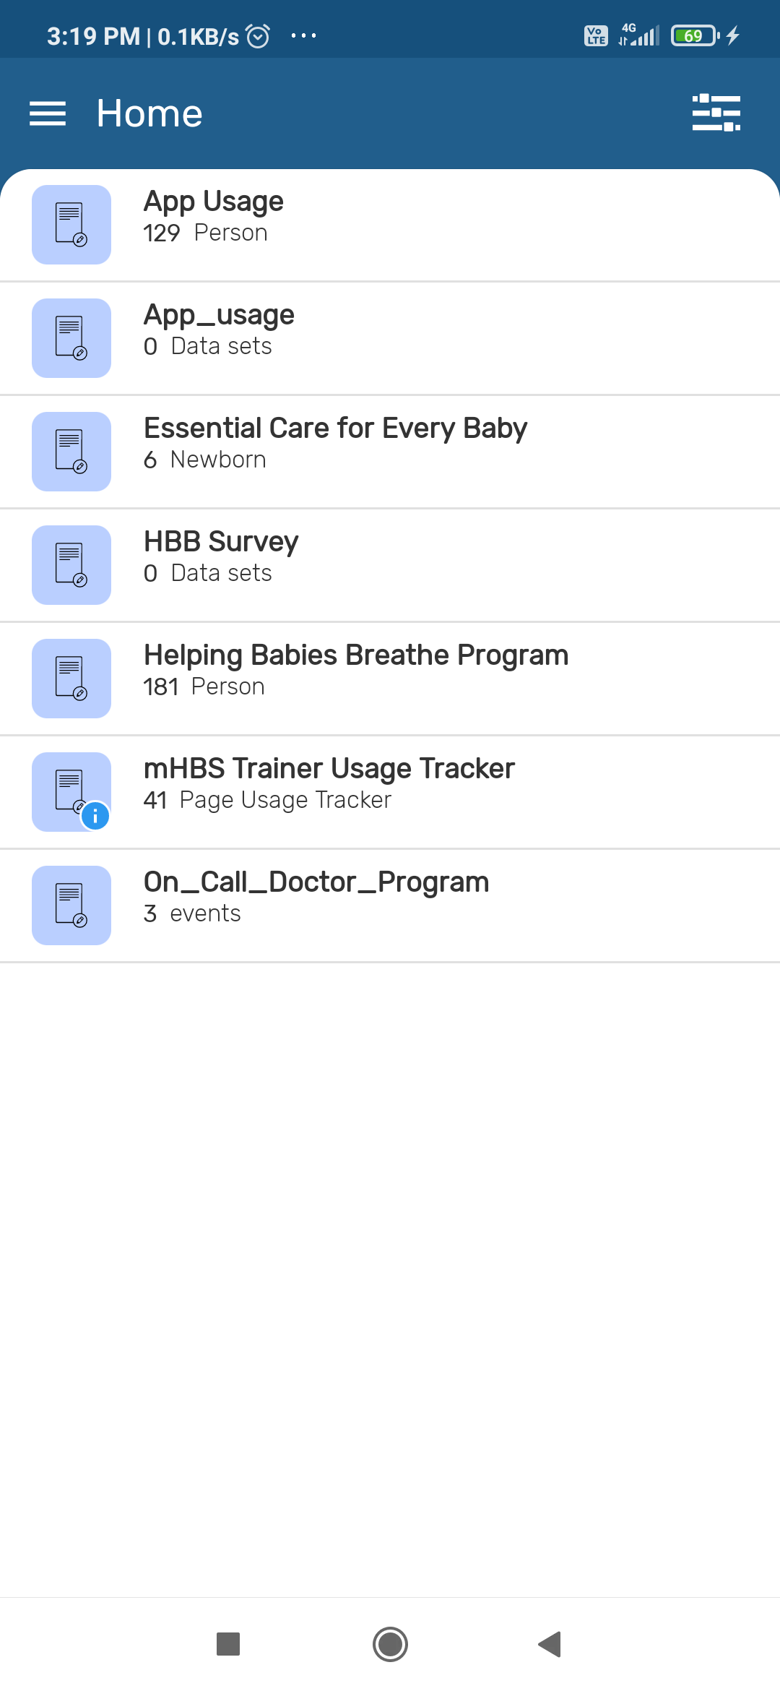
TRACKER APP
TECH :
Kotlin , Java , Python , Shell(interactive command and scripting language) , HTML ,Gradle(to build software's)
FEATURES :
#MHBS Tracker app is used to collect data from the dhis2 mobile application
#It tracks the health status of the baby in the early days of his birth.
#App usage tracker, offline support

Slide 11
THANK YOU

